Slide 1
Logistic Regression

Slide 2
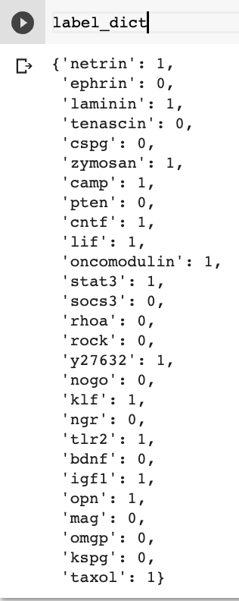
Acquire positive and negative sentences by using manually labeled molecules

Slide 3
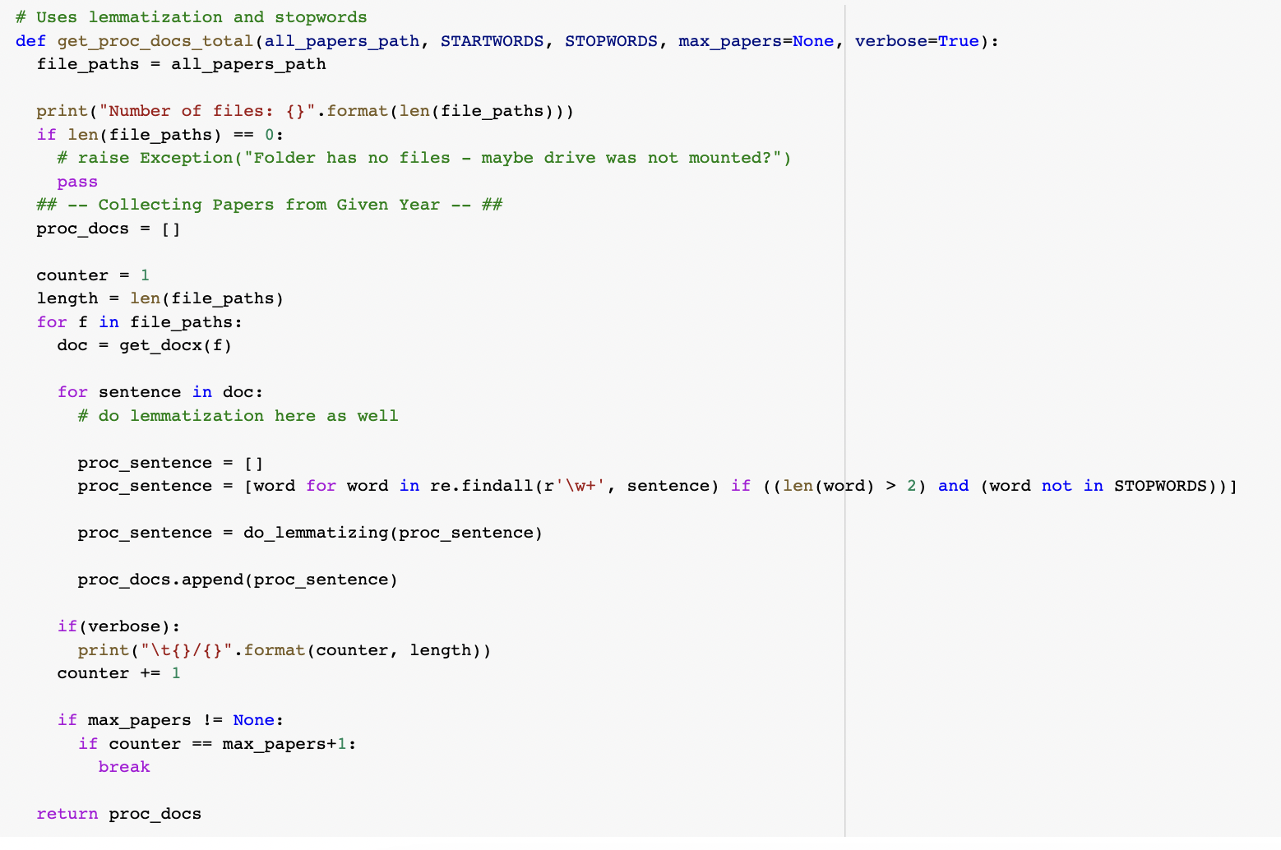
Pre-process all the sentences using lemmatization and removal of stop words

Slide 4
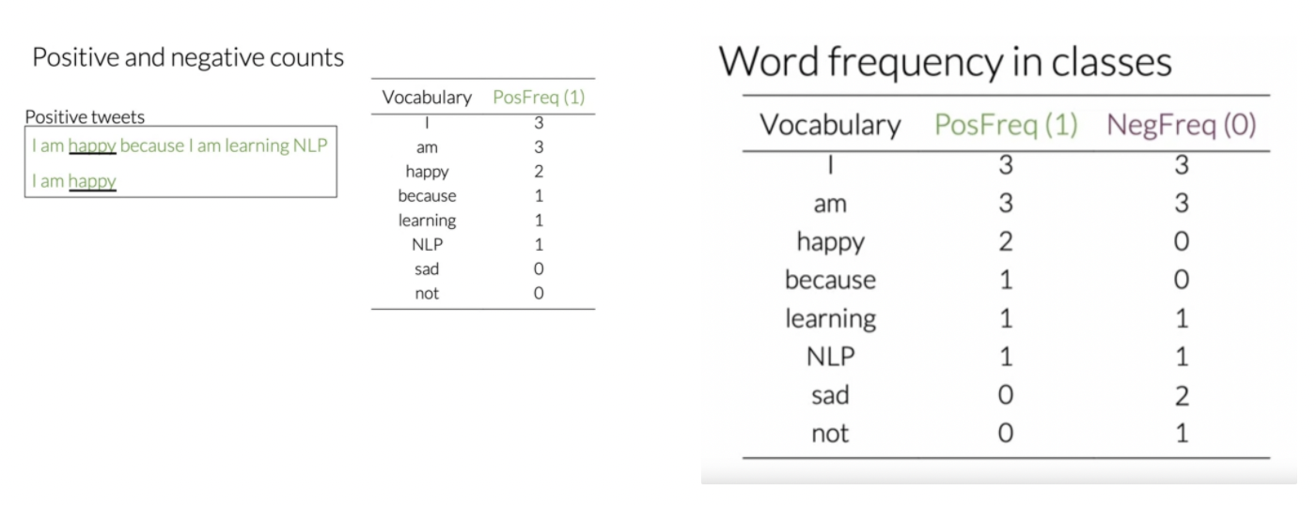
Example of frequency table

Slide 5
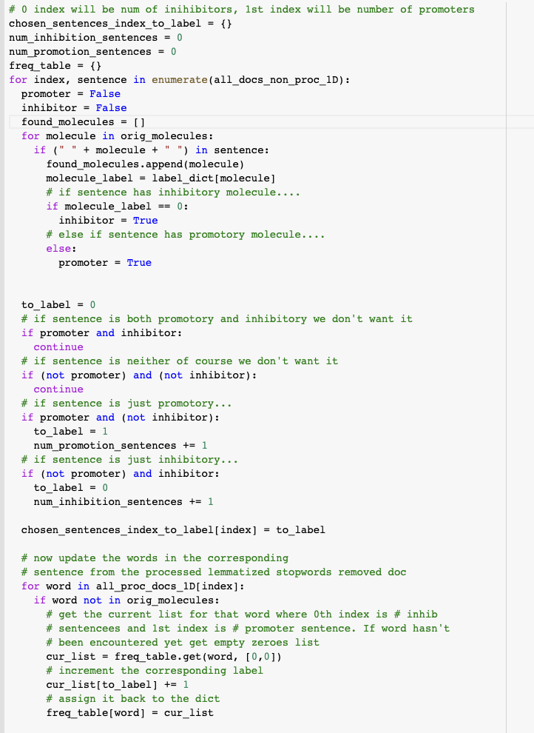
Go through all sentences and label as positive or negative using pre-labeled molecules. During this time you can also create a frequency table

Slide 6
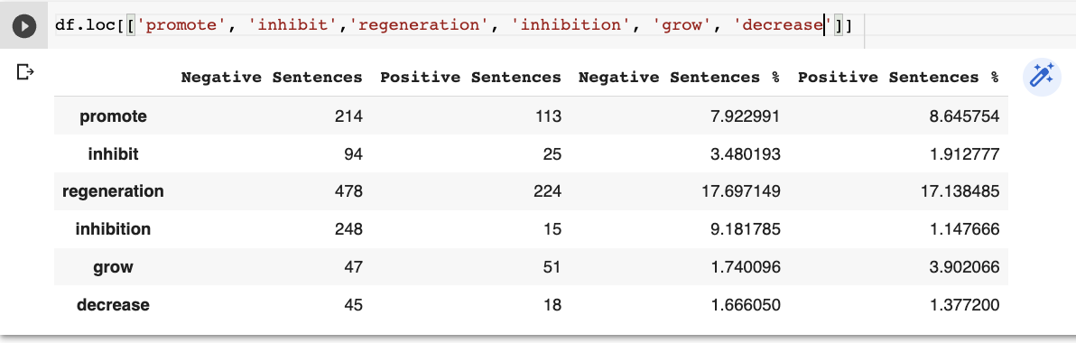
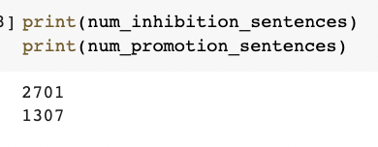
Note that I created a % column because the negative and positive sentences were of different length

Slide 7
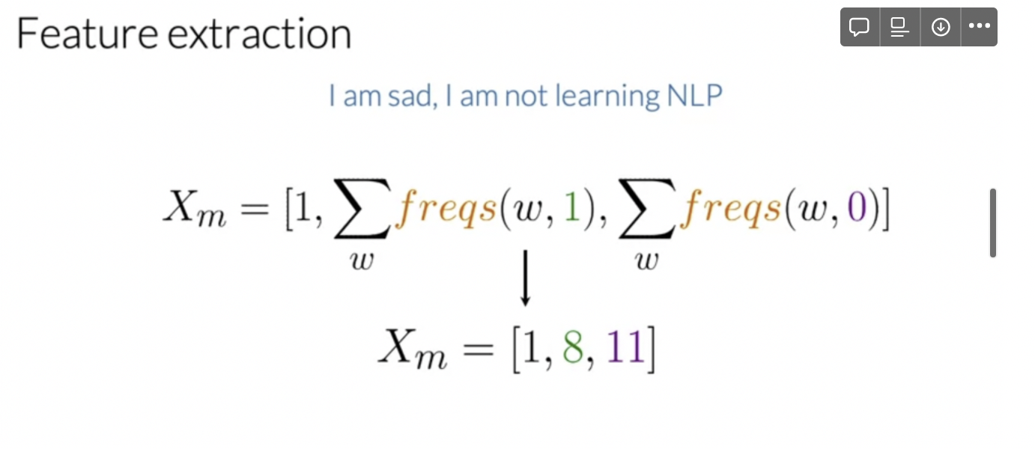
Now we have to convert each sentence into a vector using the frequency table. We simply sum up the frequencies for the positive and negative class of each words. This way we can represent a sentence as a 2D vector (3D here because of the bias term) and then plot it and train it with logistic regression

Slide 8
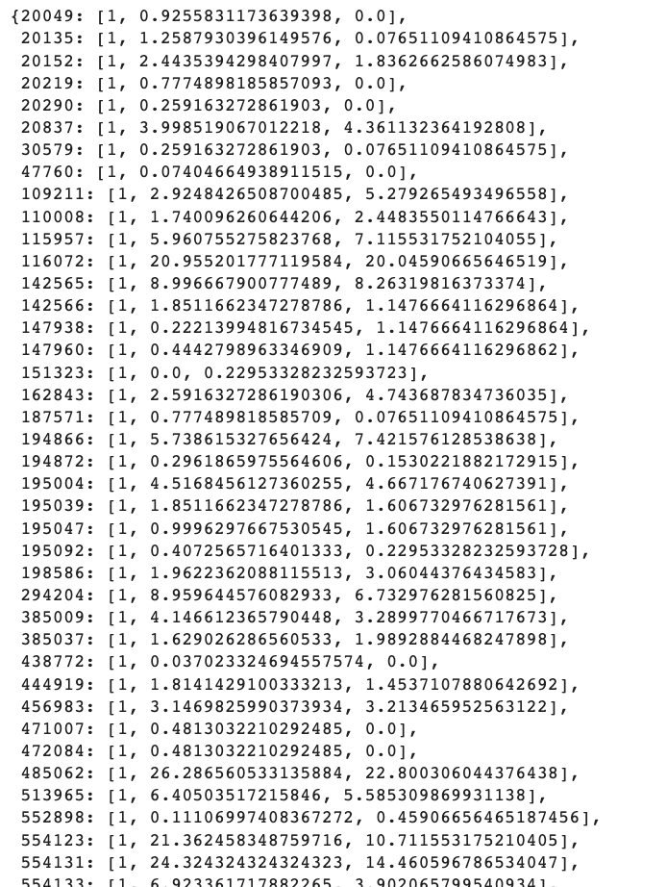
Here the keys are indexes of the sentence and you can see their vector representation

Slide 9
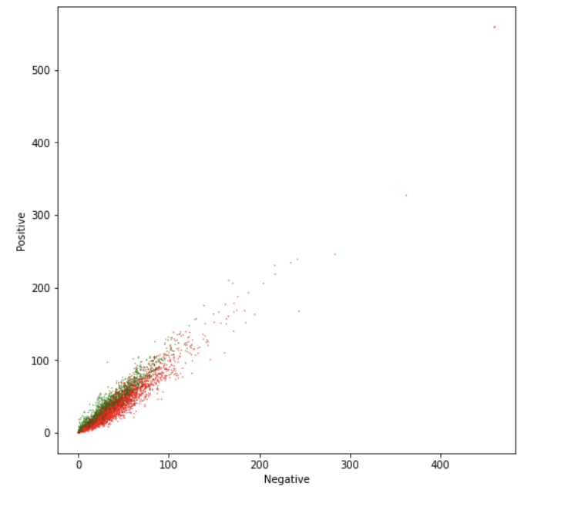
This clearly shows us that the positive and negative sentences can be separated using a logistic regression model

Slide 10
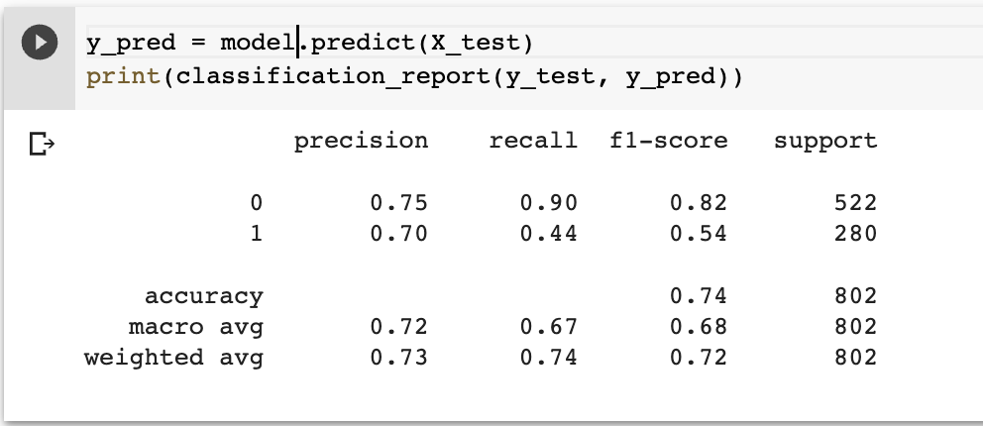
Training the logistic regression model after a 20% train test split gives the following results. Pretty good for inhibition but not so good for promotion which makes sense due to how much more negative sentences there are than positive sentences

Slide 11
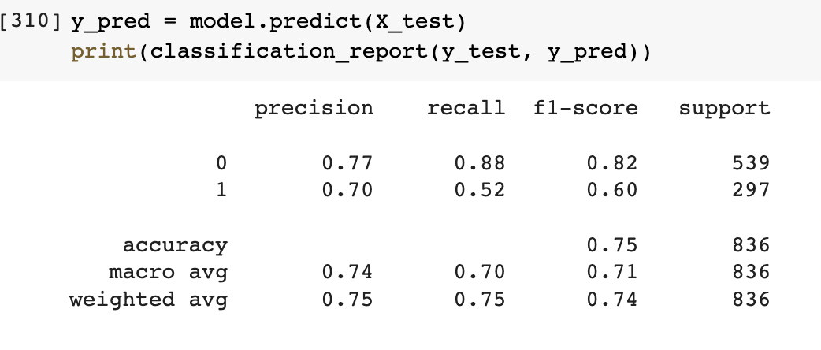
Adding 6 extra promoters (which resulted in much more positive samples to the training) helped

Slide 12
Naive-Bayes

Slide 13
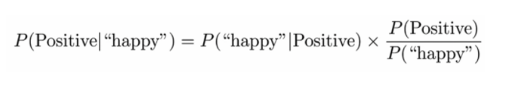

Slide 14
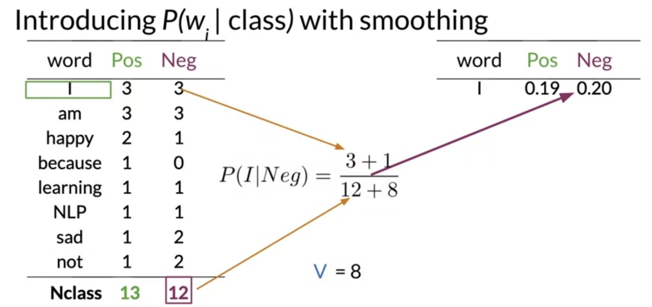

Slide 15
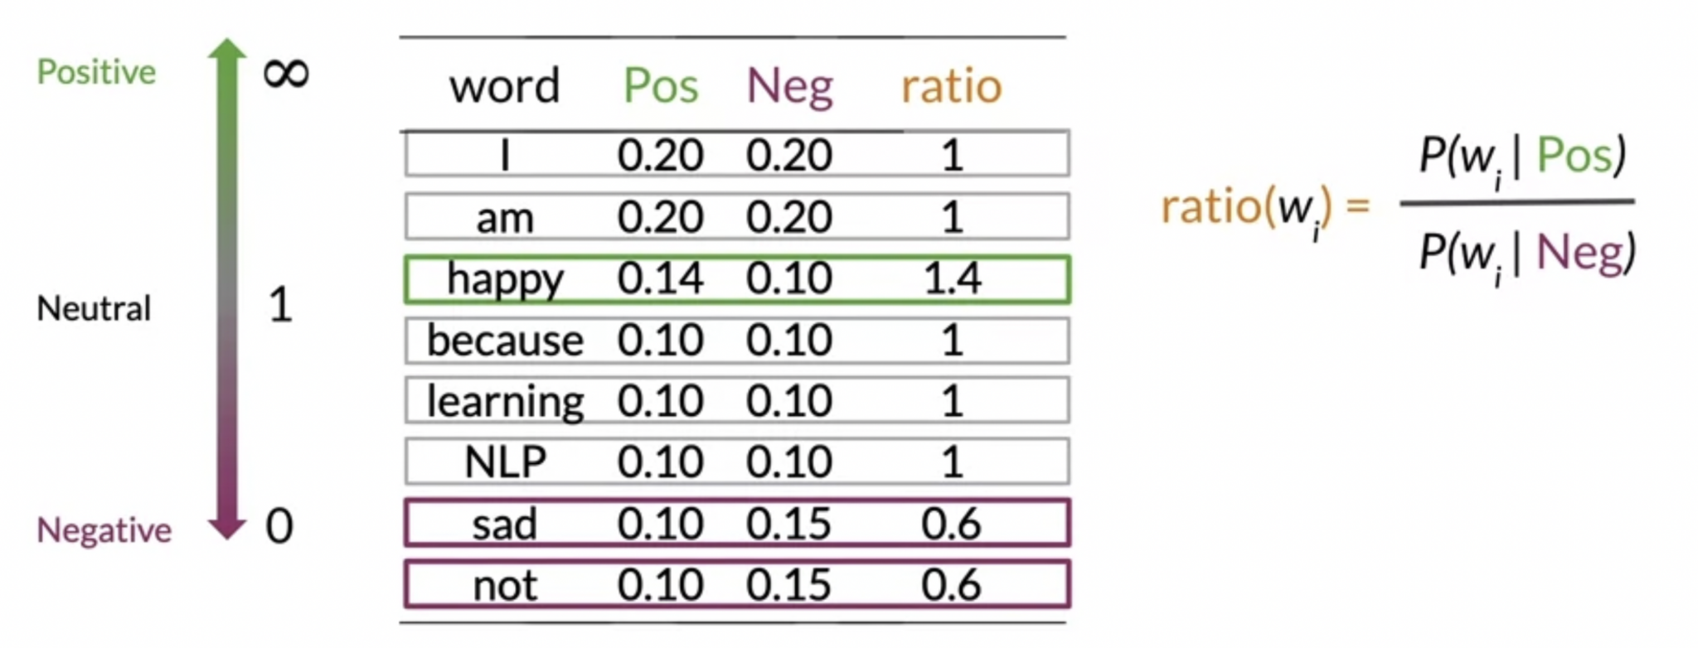

Slide 16
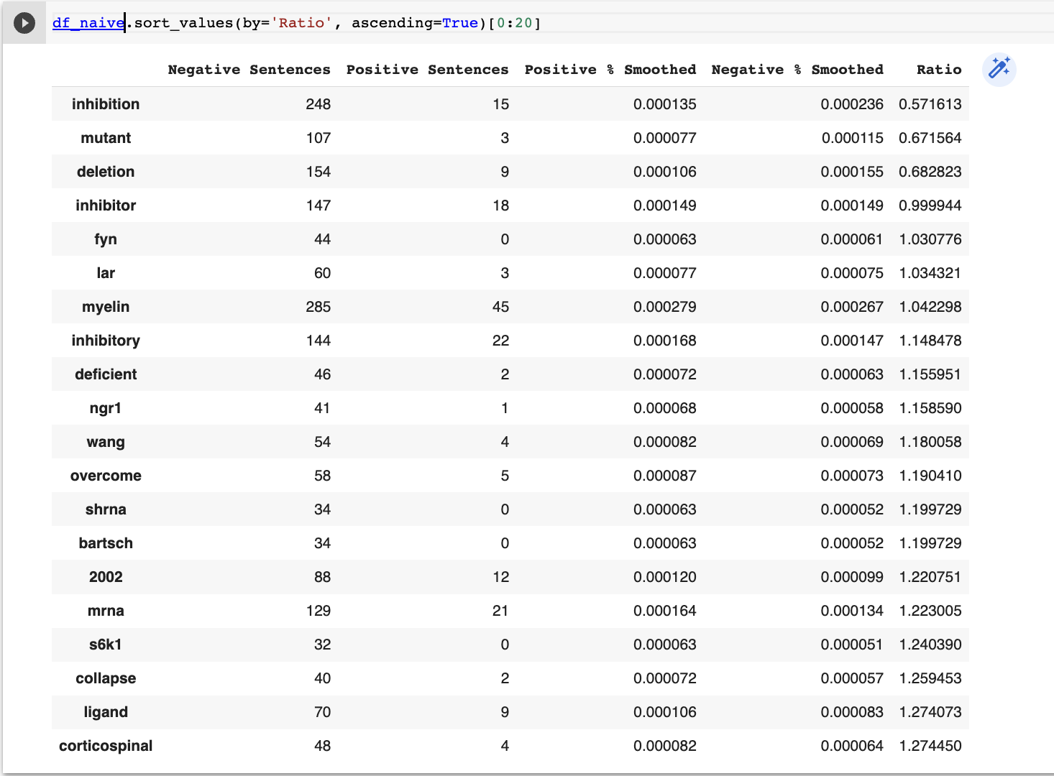
Note: ratio was done by doing positive sentences + 1 / negative sentences + 1
Some interesting results for differentiating negative sentences from positive like inhibition, mutant, deletion, inhibitor, myelin, inhibitory, deficient, overcome, collapse

Slide 17
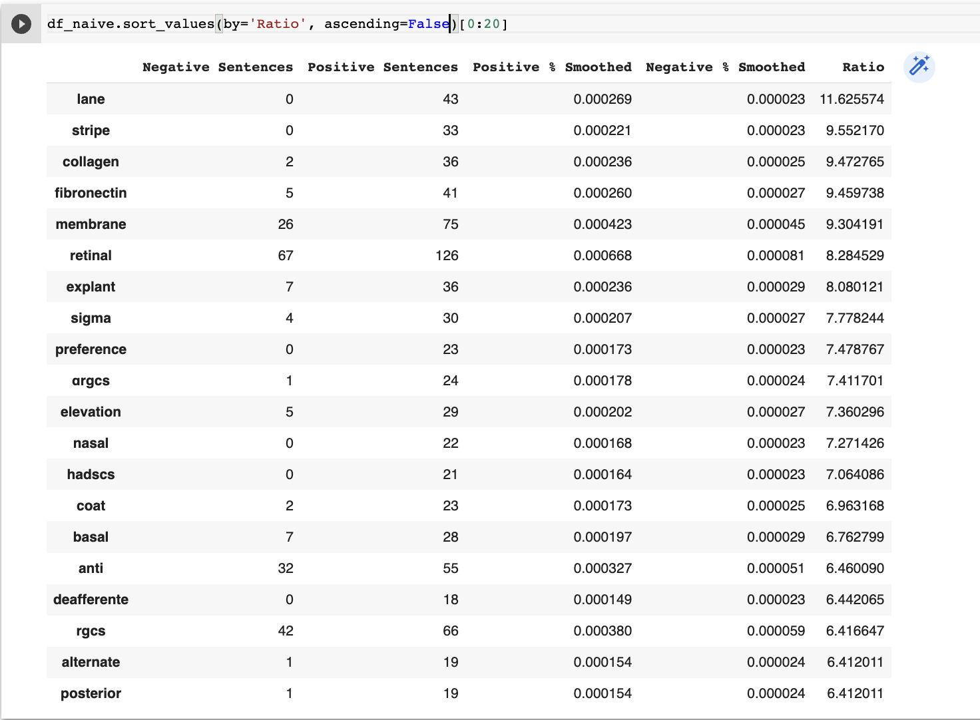
Note: ratio was done by doing positive sentences + 1 / negative sentences + 1
Nothing super striking for differentiating positive from negative

Slide 18
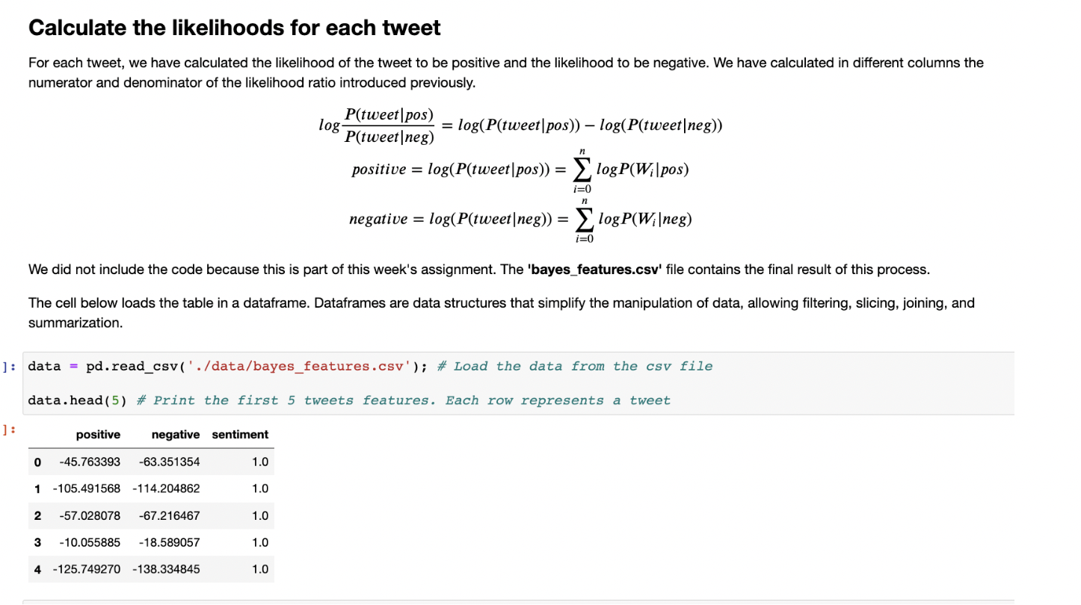

Slide 19
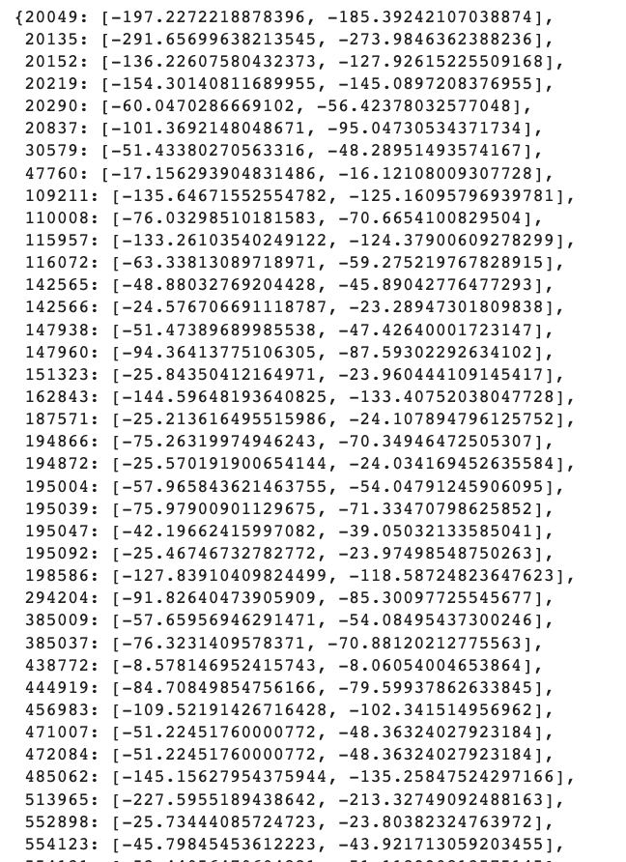
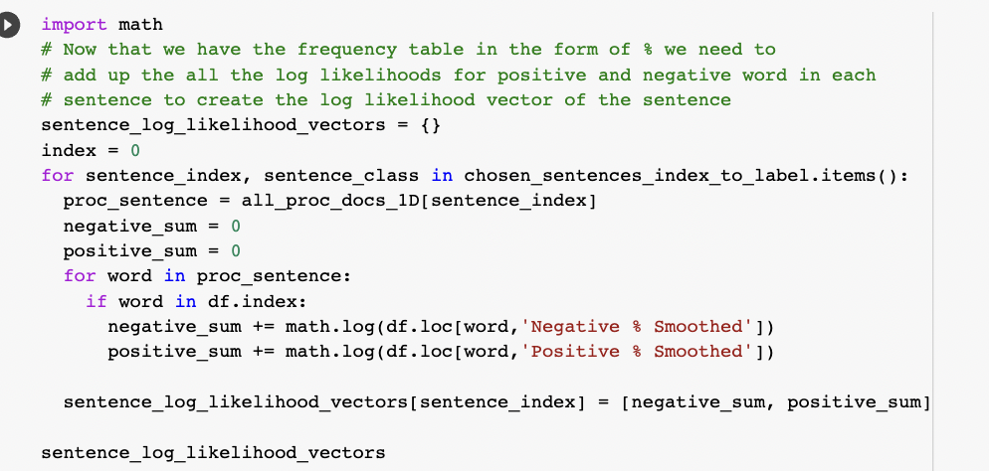
Now we can use the smoothed positive and negative samples frequencies to get a 2D vector representation of each sentence by taking sum of the log of those smoothed for positive and negative to map each dimension

Slide 20
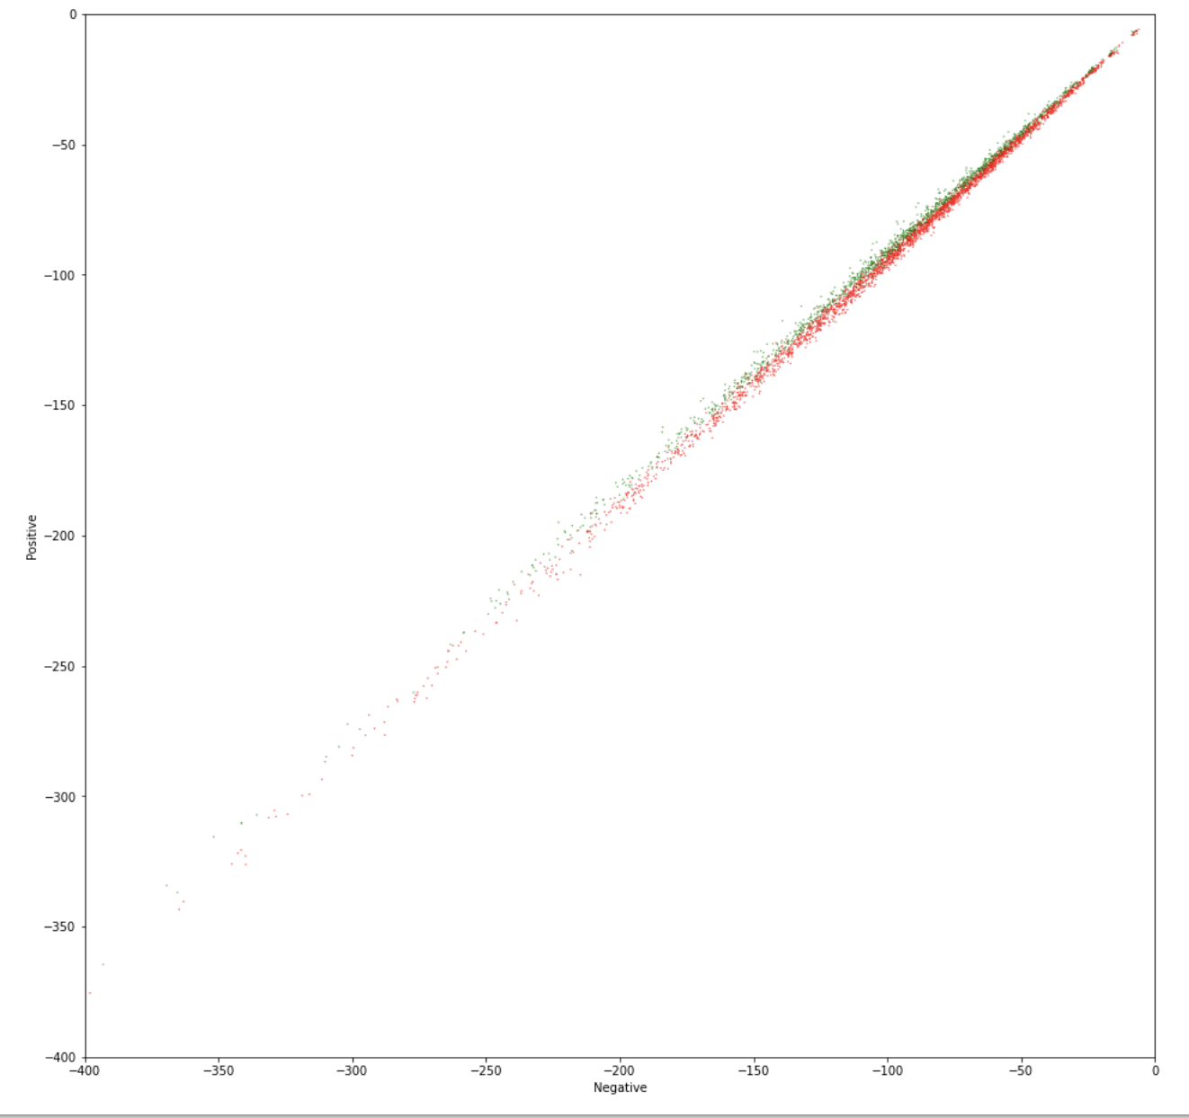
Plotting the vector representations we can see that there is a distinction between positive and negative sentences

Slide 21
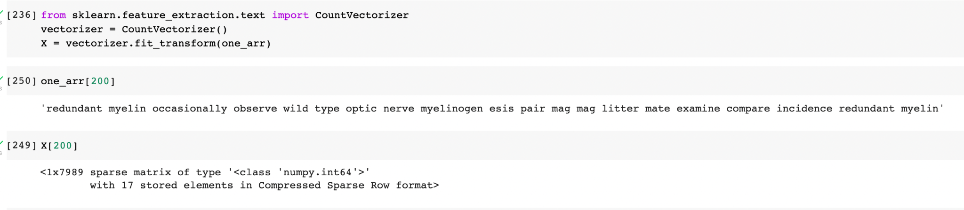
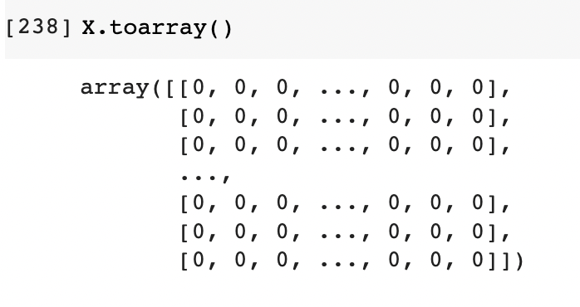
Create a count matrix from our data and use it for our features. We already have the labels for each sentence from before and we use that as our targets. Note that the count matrix is represented as a sparse array.

Slide 22
Naive-Bayes
With More Positive Sentences

Slide 23
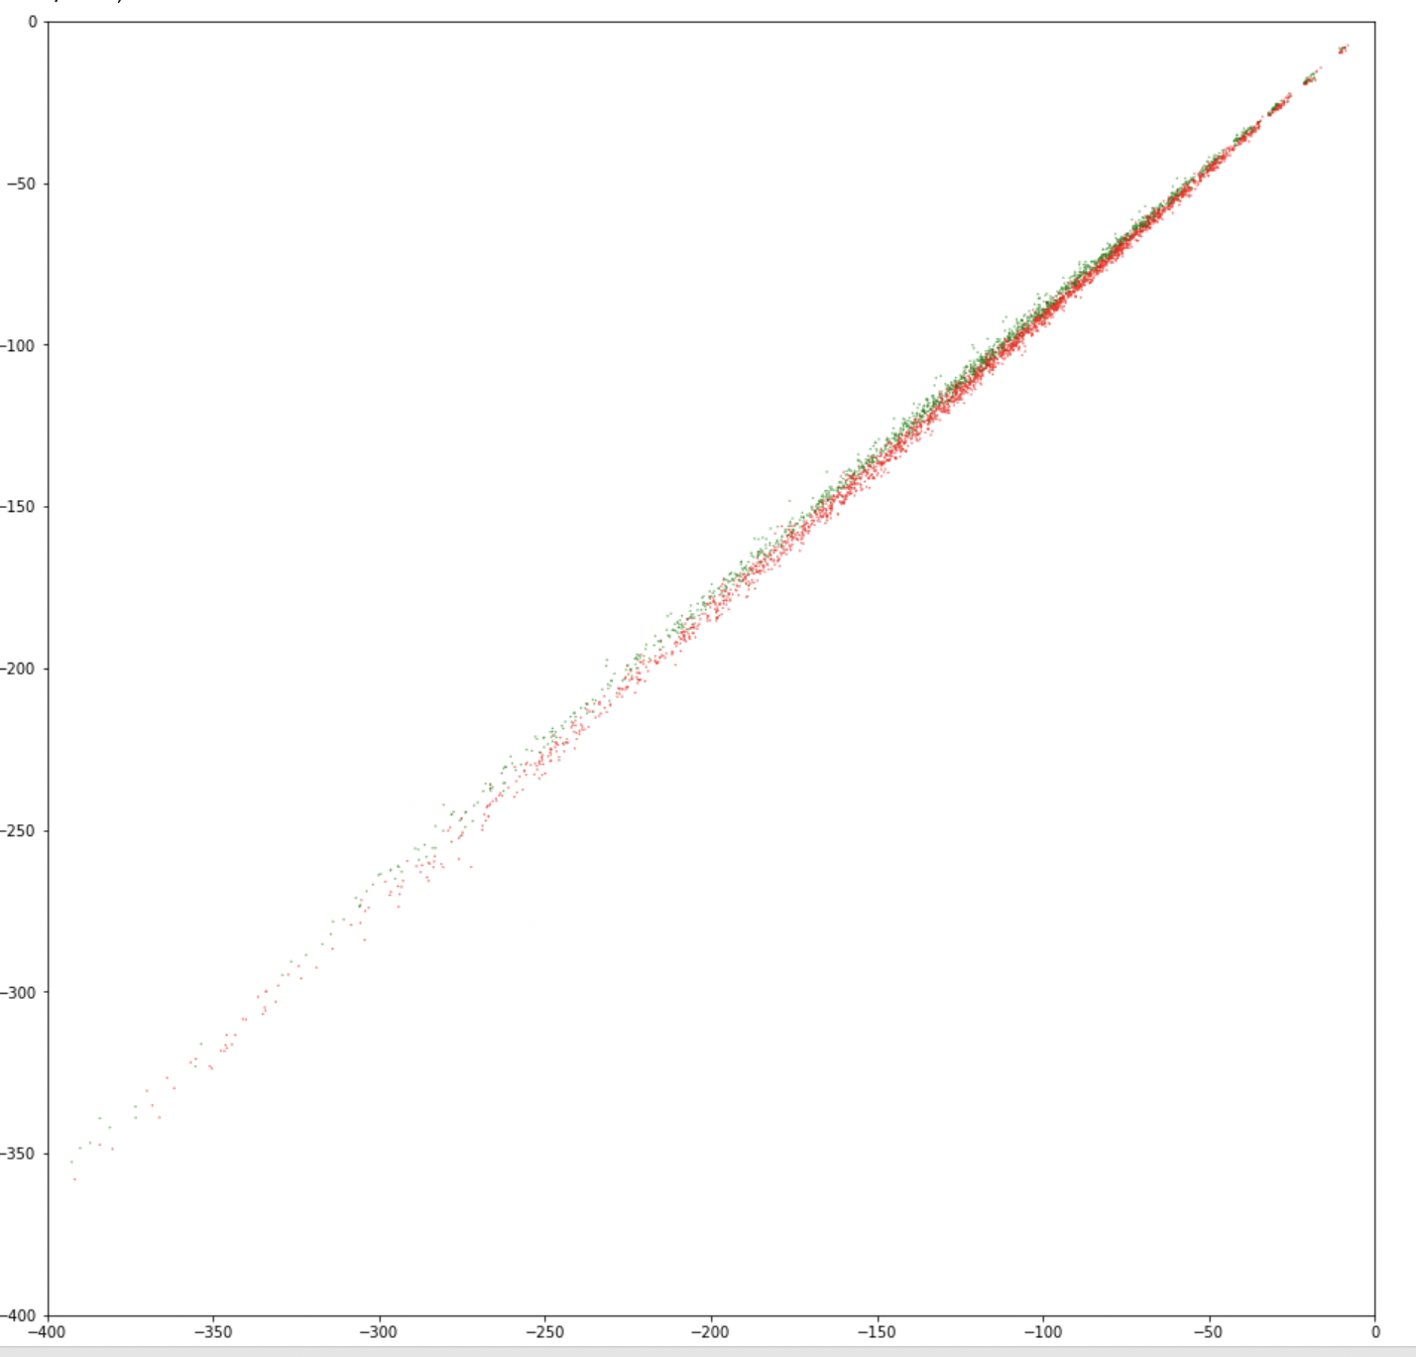
Similar to previous result

Slide 24
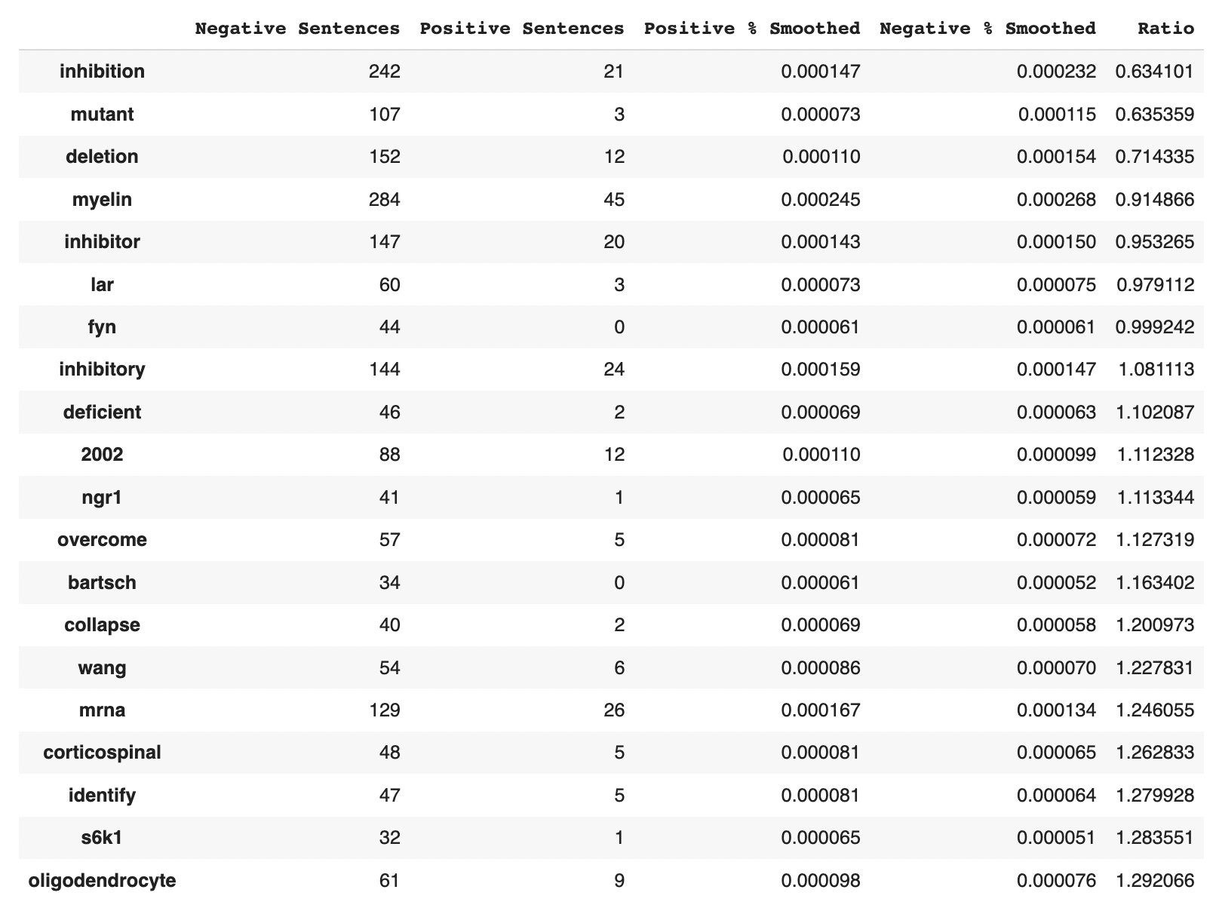
Note: ratio was done by doing positive sentences + 1 / negative sentences + 1
Found some additional interesting ones such as lar, ngr1, overcome, collapse, mrna, and oligodendrocyte

Slide 25
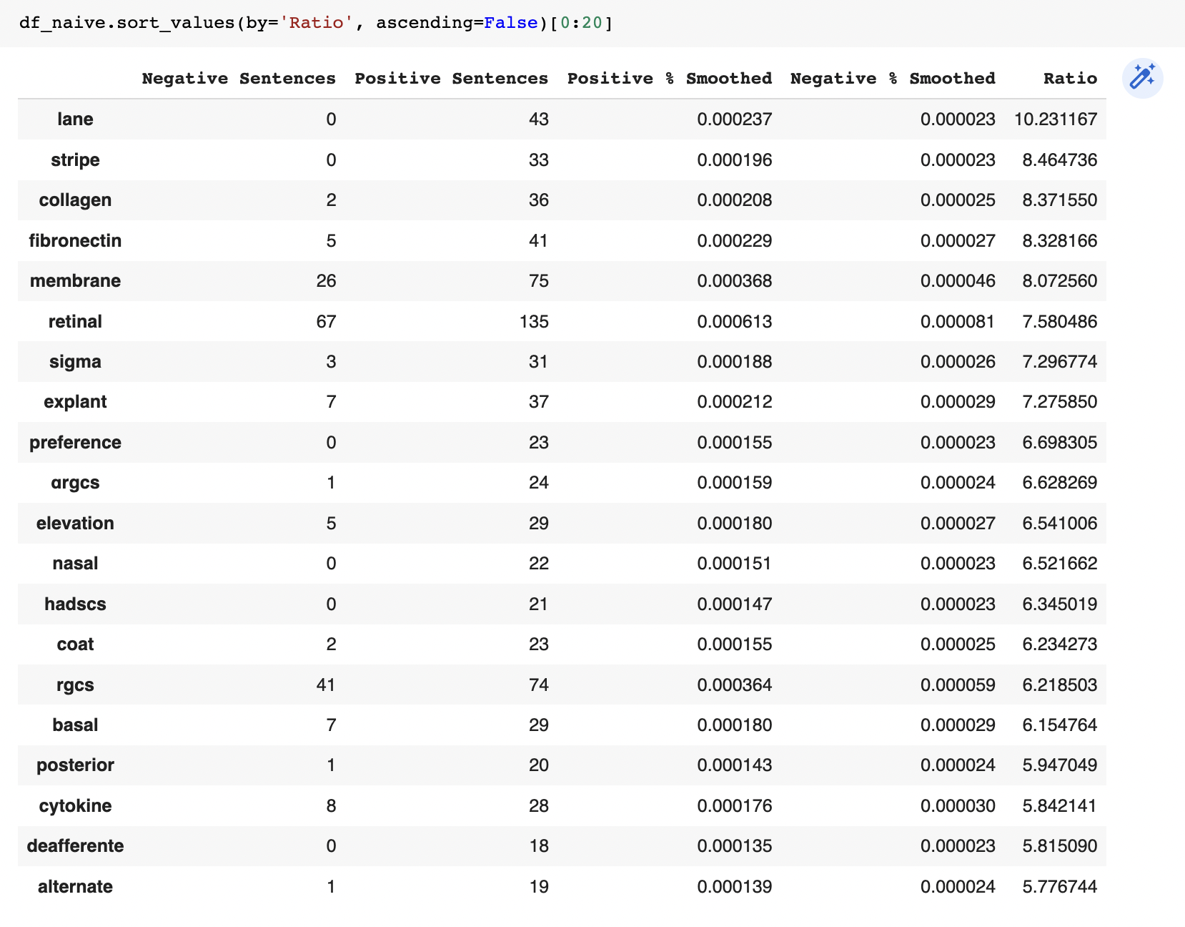
Note: ratio was done by doing positive sentences + 1 / negative sentences + 1
Still nothing interesting with 6 extra promoters

Slide 26
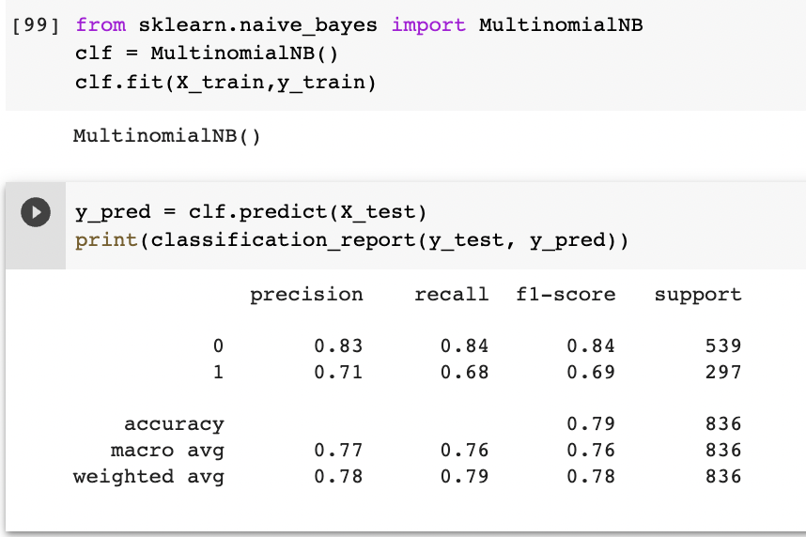
Use multinomial naive-bayes to predict from the count matrix and target
6 extra promoters helped a lot

Slide 27
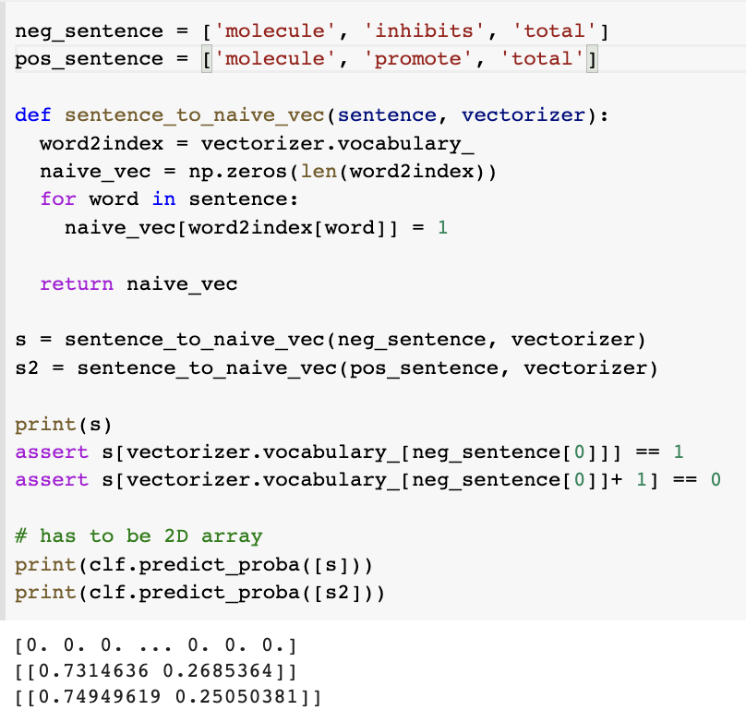
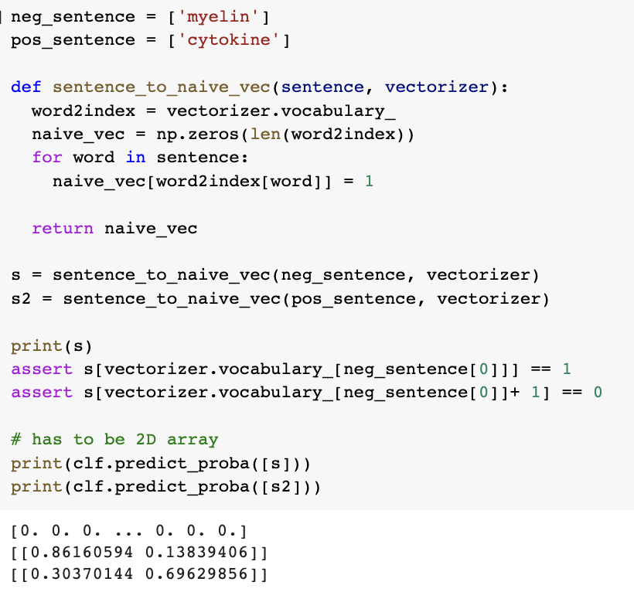
Manual predictions not super great
But works on high ratio words from previous tables

Slide 28
LR and Naive-Bayes with more even training-test split (3/29/23)
Notes:
https://colab.research.google.com/drive/1pRvVyWYCXGFAOwmiw48mk2Dm7p_hwQ0l#scrollTo=H3YaPueZfOaS

Slide 29
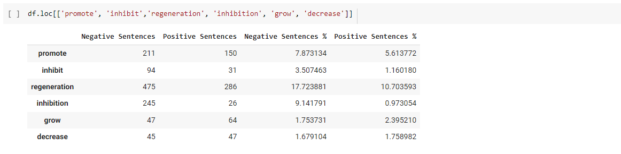
Logistic Regression
Negative words generally tend to show up in negative sentences but positive words tend to show up more in negative sentences too. That’s why if you write “this molecule decreases length of axons” it will still classify it as positive.
Notice words like promote, and regenerate actually show up in higher % of inhibitor sentences. Therefore, how will BERT really learn to recognize the differences between the meaning of a promotion vs inhibitory sentence.

Slide 30
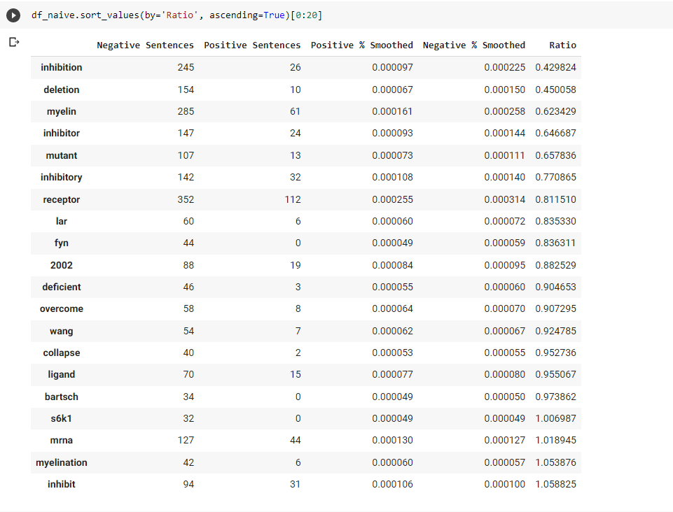
Naive-bayes
Strong detection of negative words

Slide 31
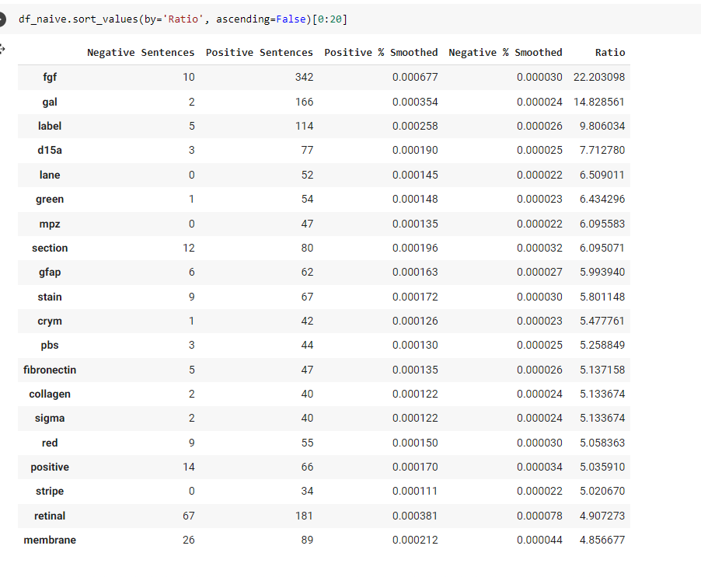
Naive-bayes
Weak detection of positive words. Over focuses on specific molecules and unimportant words
Notes:
https://colab.research.google.com/drive/1pRvVyWYCXGFAOwmiw48mk2Dm7p_hwQ0l#scrollTo=H3YaPueZfOaS

Slide 32
Word2Vec

Slide 33
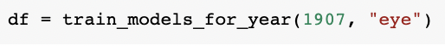
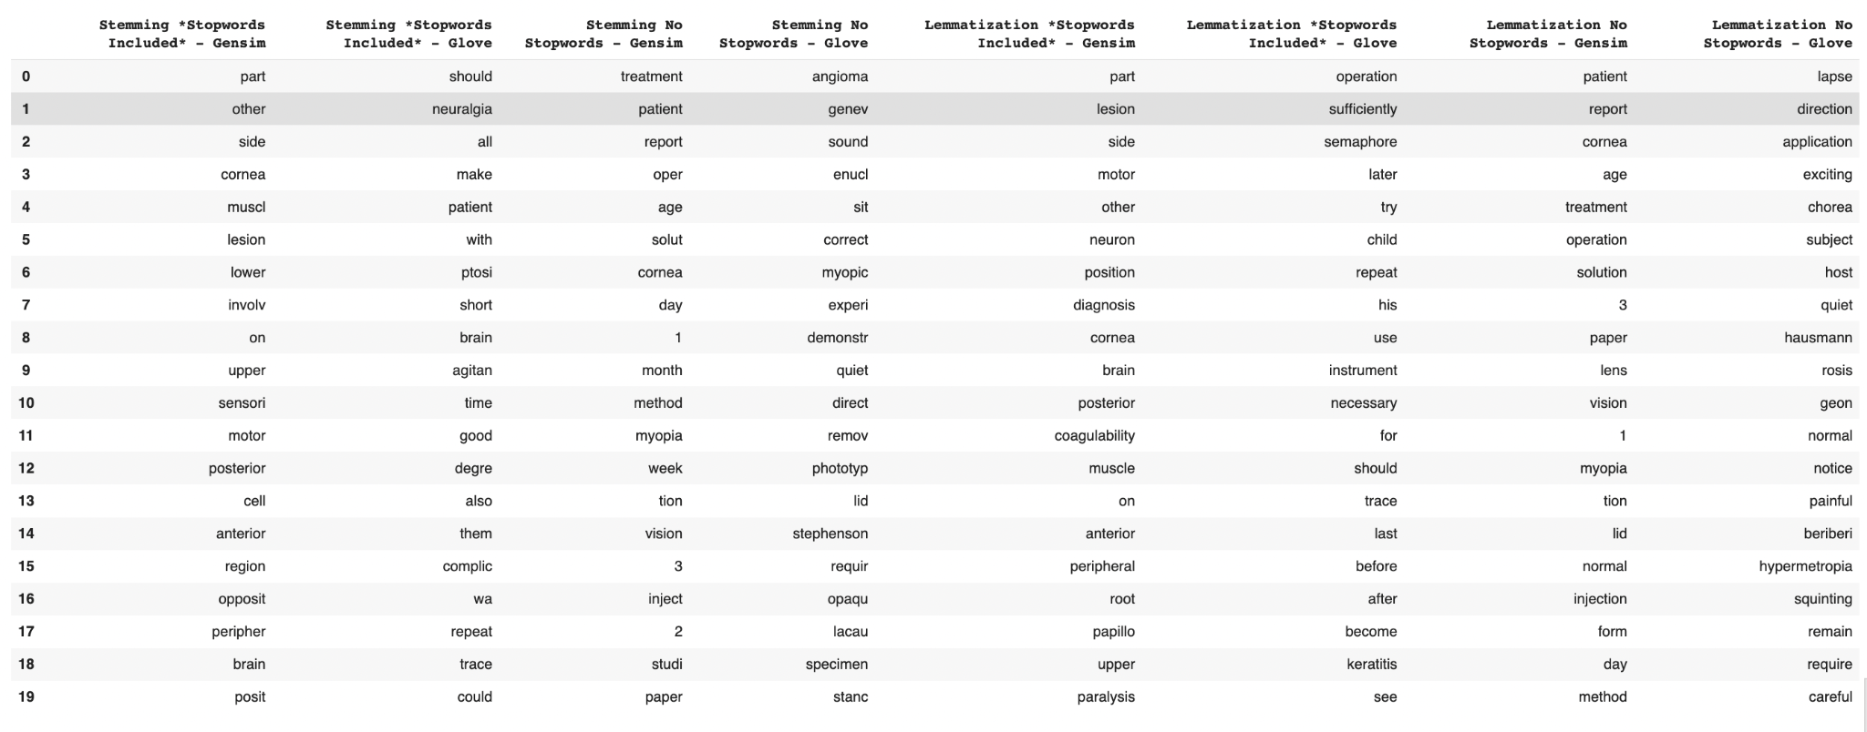
What was found was that the gensim model with lemmatization and stopwords included was the best preprocessing methodology for generating word vectors
The goal was to first find the best preprocessing methodology - gensim vs GloVe, stemming vs. lemmatizing, and including or not including stopwords.

Slide 34
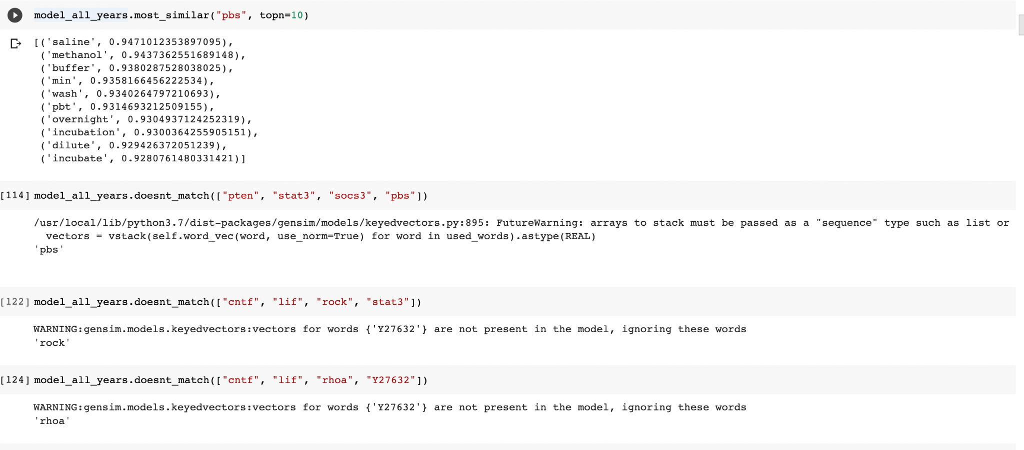
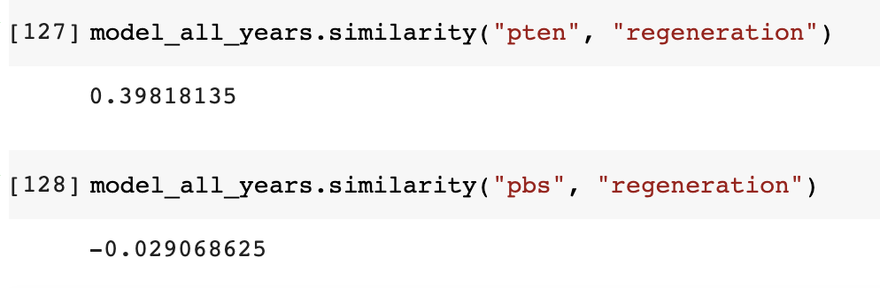
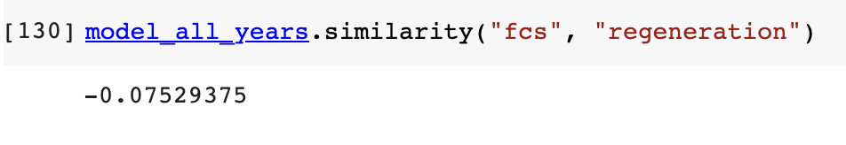
Notes:
Word2Vec Model looks pretty robust

Slide 35
Attempting to use Causal Verbs

Slide 36
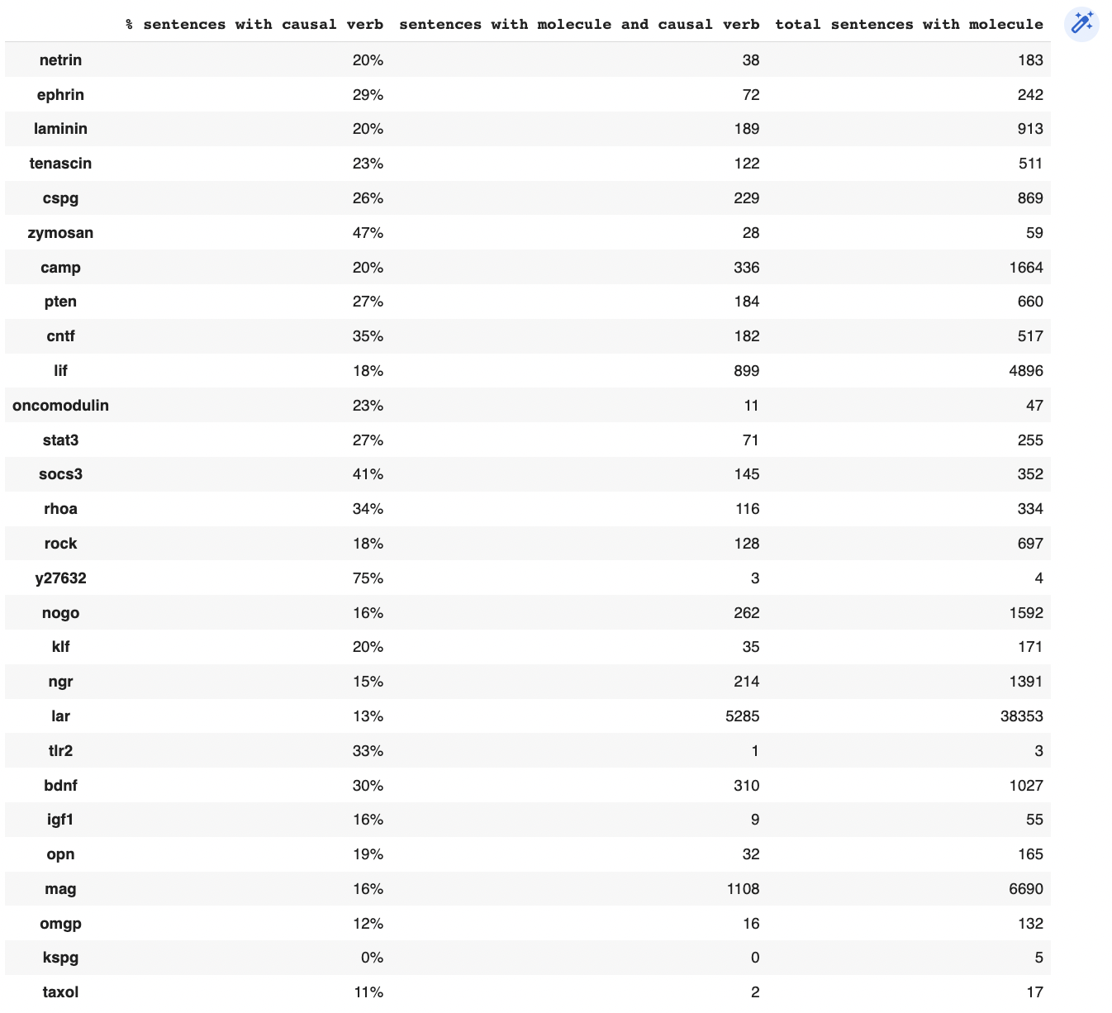
Not enough sentences have the Girju 60 causal verbs

Slide 37
Techniques to get more molecules

Slide 38
We needed to have more molecules than just the manually labeled ones for training to discover novel promoters and inhibitors and to do clustering
At first Named Entity Recognition was attempted to be used using scipy NER models but the only one that provided non-noisy results was the craft-trained model but even using that model extracted a lot of extraneous words that were not molecules
Therefore, a different approach using scipy abbreviation detector was used to determine molecules from the literature
The results were then manually curated to 822 molecules

Slide 39
Creating Graphs

Slide 40
Edge Models, Edge Link Models
file:///Users/varunkrishnan/Downloads/similarity_100.html
Uses graph links built from top 100 wordvec similarity
file:///Users/varunkrishnan/Downloads/same_sentence.html
Uses graph links built from same sentence
file:///Users/varunkrishnan/Downloads/similarity_100_strength.html
Uses graph links built from top 100 wordvec similarity and strength of links from wordvec similarity
file:///Users/varunkrishnan/Downloads/similarity_100_causal_verb_strength.html
Uses graph links built from same sentence and strength of links from causal verb scores

Slide 41
Edge Link + Node Size Models
file:///Users/varunkrishnan/Downloads/similarity_100_strength_embed_size.html
Uses graph links built from wordvec similarity, strength of links from wordvec similarity, and size of nodes from wordvec similarity to regeneration
file:///Users/varunkrishnan/Downloads/similarity_100_strength_verb_size.html
Uses graph links built from wordvec similarity, strength of links from wordvec similarity, but size of nodes built on percentage of sentences with causal verbs
file:///C:/Users/2017v/Downloads/bert_regen_graph.html
Uses graph links built from wordvec similarity, strength of links from bert score from Predict, and size of nodes on bert score
Notice how similar using causal verbs, bert score, and word2vec similarity to “regeneration” as size are correlated (top 3 are same and smallest same)

Slide 42
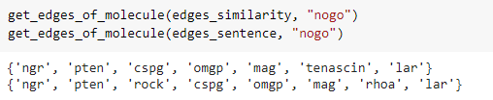

Slide 43
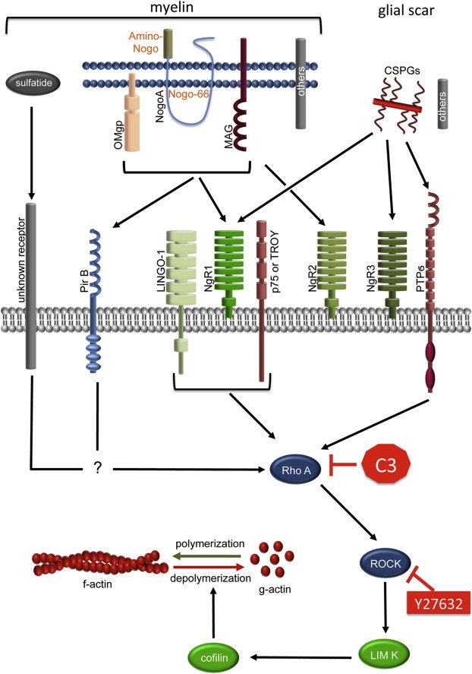

Slide 44
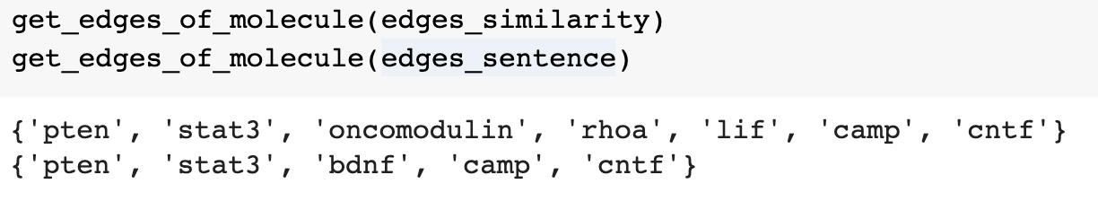
keyword=”socs3”

Slide 45
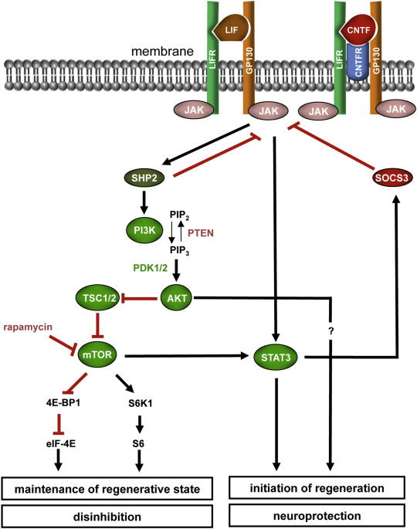

Slide 46
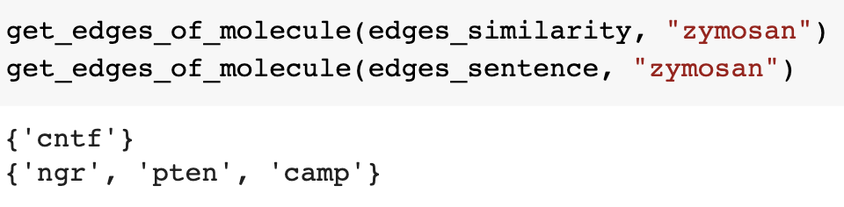

Slide 47
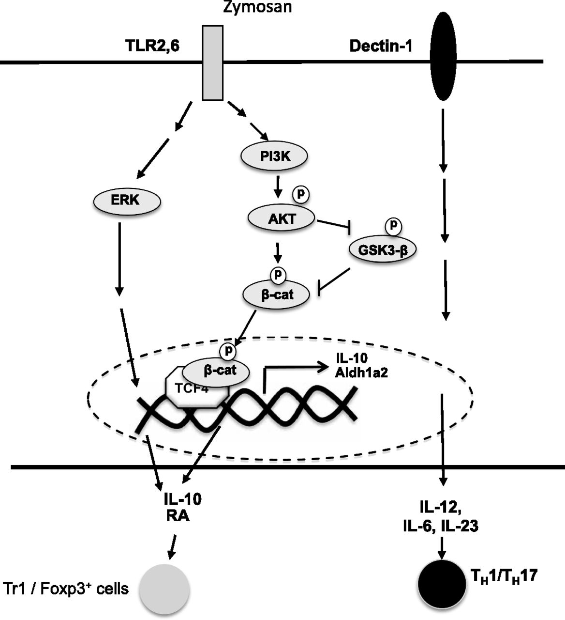

Slide 48
OTHER IMAGES

Slide 49
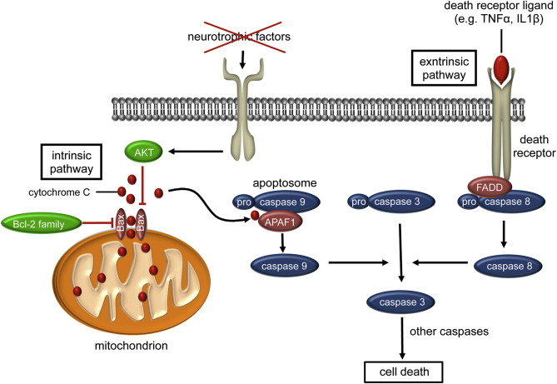

Slide 50
3 Different Graphs

Slide 51
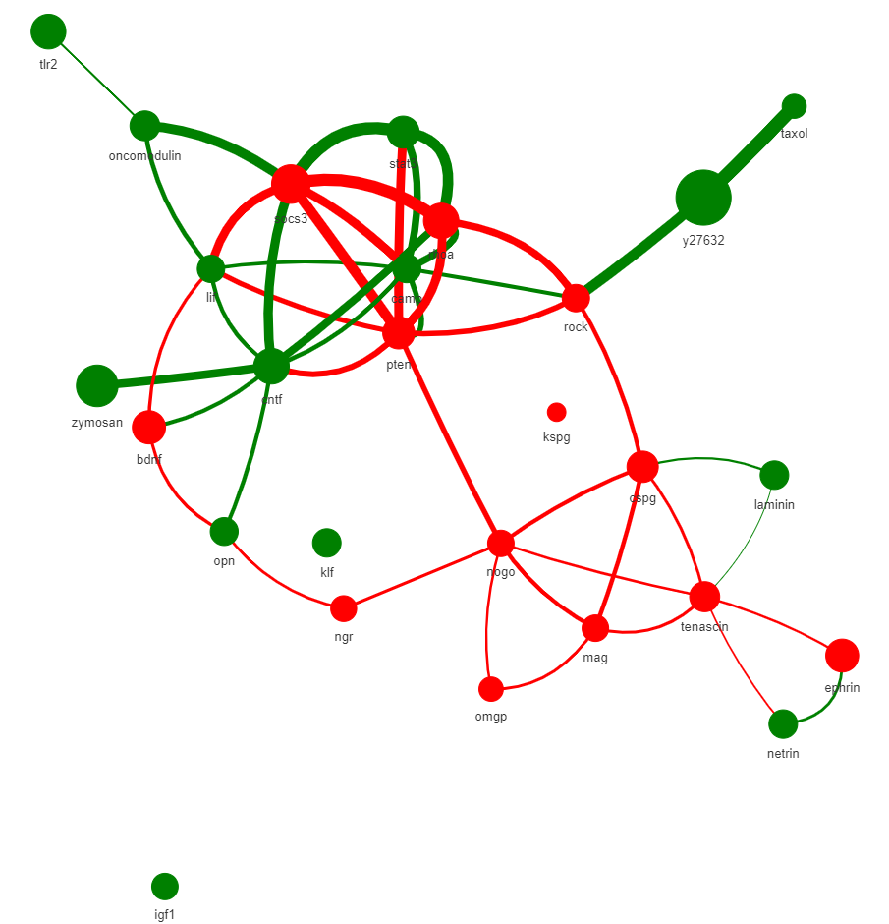
BERT

Slide 52
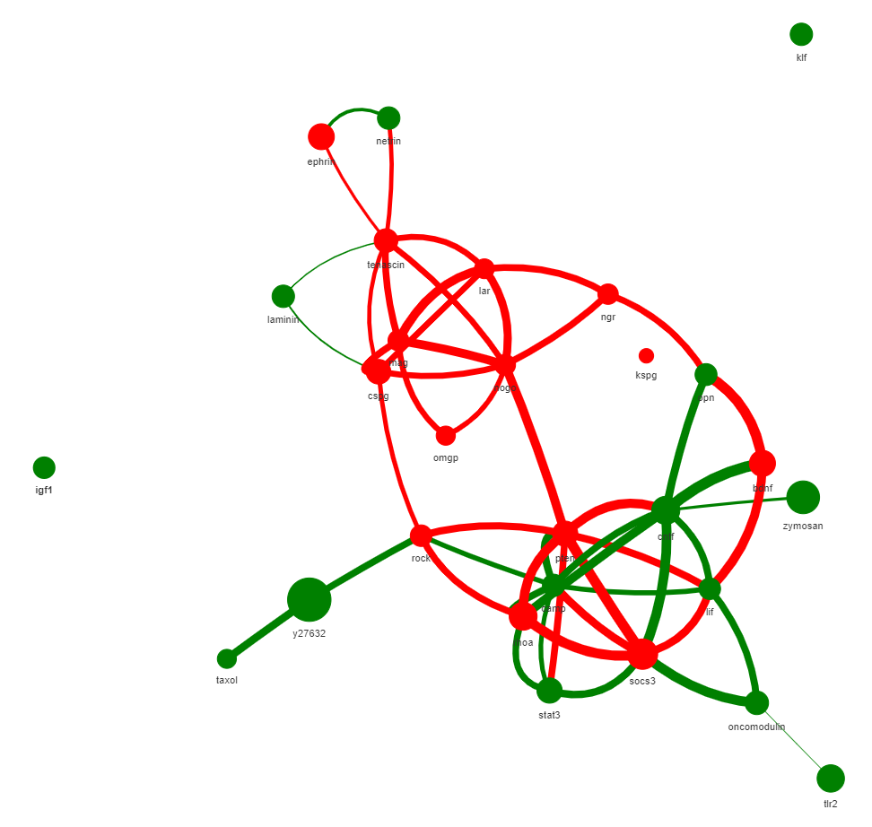
Word2Vec

Slide 53
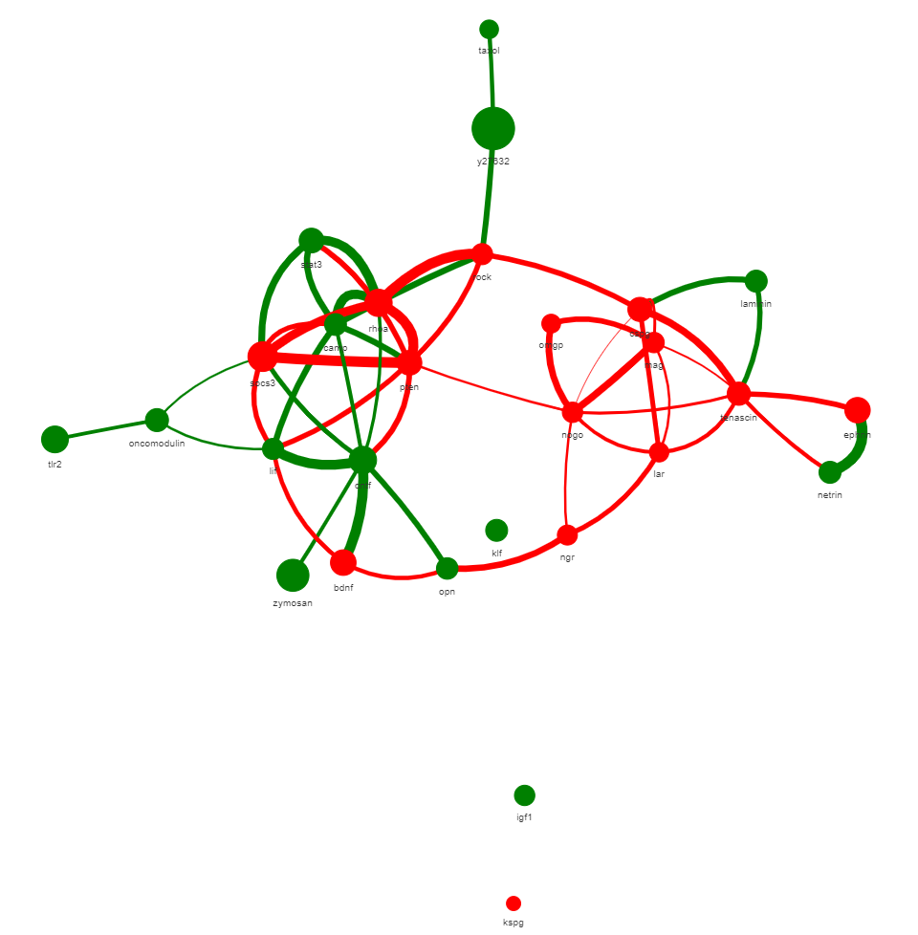
Causal Verbs

Slide 54
Word2Vec
Causal Verbs
BERT
Notes:
Notice how top 3 molecules are the same for all 3

Slide 55
Word2Vec Embeddings
10 Epochs
10 Samples

Slide 56
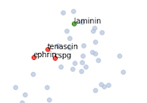
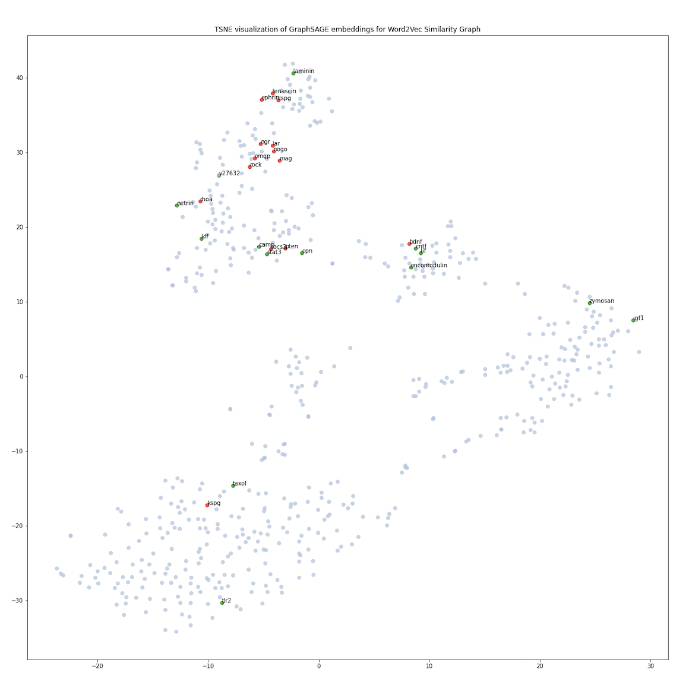
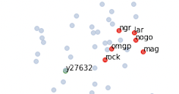


You can see it’s clustering on pathways
Seed = 99
Features = Corpus-trained Gensim Word Embeddings
Samples = 10
Links = Same Sentence
Epochs = 10
Strength = N/A

Slide 57

Seed = 101
Features = Corpus-trained Word Embeddings
Samples = 10
Links = Same Sentence
Epochs = 10
Strength = N/A

Slide 58




You can see it’s clustering on pathways
Seed = 101
Features = Corpus-trained Gensim Word Embeddings
Samples = 10
Links = Same Sentence
Epochs = 10
Strength = N/A

Slide 59


Using the full embeddings you can see top 10 most similar GraphSage Embeddings are molecules in the same pathway to STAT3 - not as good as when done with 2D Embeddings
Seed = 101
Features = Corpus-trained Gensim Word Embeddings
Samples = 10
Links = Same Sentence
Epochs = 10
Strength = N/A

Slide 60


Seed = 101
Features = Corpus-trained Gensim Word Embeddings
Samples = 10
Links = Same Sentence
Epochs = 10
Strength = N/A

Slide 61


All of these are already known promoters and inhibitors
Seed = 101
Features = Corpus-trained Gensim Word Embeddings
Samples = 10
Links = Same Sentence
Epochs = 10
Strength = N/A
Notes:
Amp - promoter, rock2 is inhibitor, akt - promoter, map1b - promoter

Slide 62


Using the full embeddings you can see top 10 most similar GraphSage Embeddings are molecules in the same pathway to ROCK - not as good as when done with 2D Embeddings
Seed = 101
Features = Corpus-trained Gensim Word Embeddings
Samples = 10
Links = Same Sentence
Epochs = 10
Strength = N/A

Slide 63


All of these are already known promoters and inhibitors
Seed = 101
Features = Corpus-trained Gensim Word Embeddings
Samples = 10
Links = Same Sentence
Epochs = 10
Strength = N/A
Notes:
Rgma - promoter, s1pr2 - inhibitor, pip2 - promoter, ncam - promoter, s6k1 - promoter

Slide 64


Using the full embeddings you can see top 10 most similar GraphSage Embeddings are molecules in the same pathway to PI3K - not as good as when done with 2D Embeddings
Seed = 101
Features = Corpus-trained Gensim Word Embeddings
Samples = 10
Links = Same Sentence
Epochs = 10
Strength = N/A

Slide 65


All of these are already known promoters and inhibitors
Seed = 101
Features = Corpus-trained Gensim Word Embeddings
Samples = 10
Links = Same Sentence
Epochs = 10
Strength = N/A
Notes:
dbcamp - promoter, pp2a - promoter, jun - promoter, tsc1- promoter, abl - promoter

Slide 66


A little unclear with cntf which pathways these molecules belong
Seed = 101
Features = Corpus-trained Gensim Word Embeddings
Samples = 10
Links = Same Sentence
Epochs = 10
Strength = N/A

Slide 67


Features = Corpus-trained Word Embeddings
Samples = 10
Links = WordVec Simil
Epochs = 10
Strength = N/A
Notes:
Notice how top 3 molecules are the same for all 3

Slide 68

Features = Corpus-trained Word Embeddings
Samples = 10
Links = WordVec Simil
Epochs = 10
Strength = N/A
Notes:
Notice how top 3 molecules are the same for all 3

Slide 69


Features = Corpus-trained Word Embeddings
Samples = 10
Links = Same Sentence
Epochs = 10
Strength = N/A
Notes:
Notice how top 3 molecules are the same for all 3

Slide 70

Features = Corpus-trained Word Embeddings
Samples = 10
Links = Same Sentence
Epochs = 10
Strength = N/A
Notes:
Notice how top 3 molecules are the same for all 3

Slide 71
FastText Embeddings
10 epochs

Slide 72





Seed = 99
Features = Corpus-trained FastText Word Embeddings
Samples = 10
Links = Same Sentence
Epochs = 10
Strength = N/A

Slide 73



Seed = 99 (another iteration)
Features = Corpus-trained FastText Word Embeddings
Samples = 10
Links = Same Sentence
Epochs = 10
Strength = N/A

Slide 74


Determining close molecules for stats3 - you can get a lot more novel molecules with fasttext embeddings
Verified Candidates for Dr. B:
MOS - inhibition, IL-6 promotion, ifn-gamma - promoter, apc - inhibitor, tmrd - promoter, aqp4 - unknown, plp - inhibitor
Seed = 99
Features = Corpus-trained FastText Word Embeddings
Samples = 10
Links = Same Sentence
Epochs = 10
Strength = N/A
Notes:
MOS - inhibition, IL-6 promotion, ifn-gamma - promoter, apc - inhibitor, tmrd - promoter, aqp4 - unknown, plp - inhibitor

Slide 75


Determining close molecules for stats3 - you can get a lot more novel molecules with fasttext embeddings
Verified Candidates for Dr. B:
Gsk3 - inhibitor, gsk3beta - inhibitor, caspases - inhibitor, py397 fak (basically phosphorylated fak) - promoter, mptp - inhibition
Seed = 99
Features = Corpus-trained FastText Word Embeddings
Samples = 10
Links = Same Sentence
Epochs = 10
Strength = N/A
Notes:
Gsk3 - inhibitor, caspases - inhibitor, py397 fak (basically phosphorylated fak) - promoter, mptp - inhibition

Slide 76


Determining close molecules for socs3 - you can get a lot more novel molecules with fasttext embeddings
Verified Candidates for Dr. B:
All known molecules
Seed = 99
Features = Corpus-trained FastText Word Embeddings
Samples = 10
Links = Same Sentence
Epochs = 10
Strength = N/A
Notes:
Gsk3 - inhibitor, caspases - inhibitor, py397 fak (basically phosphorylated fak) - promoter, mptp - inhibition

Slide 77


Determining close molecules for cspg - you can get a lot more novel molecules with fasttext embeddings
Verified Candidates for Dr. B:
Ptp - inhibitor, hspg - promoter
Seed = 99
Features = Corpus-trained FastText Word Embeddings
Samples = 10
Links = Same Sentence
Epochs = 10
Strength = N/A
Notes:
Gsk3 - inhibitor, caspases - inhibitor, py397 fak (basically phosphorylated fak) - promoter, mptp - inhibition

Slide 78


Determining close molecules for rock - you can get a lot more novel molecules with fasttext embeddings
Verified Candidates for Dr. B:
crmp2 - inhibition, dlk - inhibition (but these are not new molecules), s1pr2 - inhibition
Seed = 99
Features = Corpus-trained FastText Word Embeddings
Samples = 10
Links = Same Sentence
Epochs = 10
Strength = N/A
Notes:
Gsk3 - inhibitor, caspases - inhibitor, py397 fak (basically phosphorylated fak) - promoter, mptp - inhibition

Slide 79


Determining close molecules for zymosan - you can get a lot more novel molecules with fasttext embeddings
Verified Candidates for Dr. B:
Inpp5f - inhibition, ngn-1 promoter, nfat - inhibition, kab-raf - promoter
Seed = 99
Features = Corpus-trained FastText Word Embeddings
Samples = 10
Links = Same Sentence
Epochs = 10
Strength = N/A
Notes:
Gsk3 - inhibitor, caspases - inhibitor, py397 fak (basically phosphorylated fak) - promoter, mptp - inhibition

Slide 80


Determining close molecules for rhoa - you can get a lot more novel molecules with fasttext embeddings
Verified Candidates for Dr. B:
No good candidates
Seed = 101
Features = Corpus-trained FastText Word Embeddings
Samples = 10
Links = Same Sentence
Epochs = 10
Strength = N/A
Notes:
Gsk3 - inhibitor, caspases - inhibitor, py397 fak (basically phosphorylated fak) - promoter, mptp - inhibition

Slide 81


Determining close molecules for nogo - you can get a lot more novel molecules with fasttext embeddings
Verified Candidates for Dr. B:
s1pr2 - inhibitor, inpp5f - inhibitor
Seed = 101
Features = Corpus-trained FastText Word Embeddings
Samples = 10
Links = Same Sentence
Epochs = 10
Strength = N/A
Notes:
Gsk3 - inhibitor, caspases - inhibitor, py397 fak (basically phosphorylated fak) - promoter, mptp - inhibition

Slide 82





Seed = 101
Features = Corpus-trained FastText Word Embeddings
Samples = 10
Links = Same Sentence
Epochs = 10
Strength = N/A

Slide 83

Using BERT word embeddings doesn’t really work because the word embeddings cosine similarities don’t tell us much information
Notes:
Notice how top 3 molecules are the same for all 3

Slide 84

You can see the clustering was terrible
Notes:
Notice how top 3 molecules are the same for all 3

Slide 85
Supervised
Training

Slide 86


Out of the 4336 sentences with the known 28 promoters and inhibitors labeled, 97% of the sentences contain only promoters or only inhibitors making training a BERT model on if a sentence is promotery or inhibitory possible

Slide 87



Slide 89


1 = promoters
0 = inhibitors
BERT was trained on 1,279 sentences with only promoters, 2631 sentences with only inhibitors for the 2 class version
Note: Sentences with both promoters and inhibitors were excluded from training

Slide 90





Slide 91


Logistic Regression Weighted F1: 0.74
Naive-Bayes Weighted F1: 0.78

Slide 92



Slide 93
BERT MODEL

Slide 94


Slide 95


We then can use BERT to predict the labels of all 822 molecules → this will then have to be manually checked by the wet lab team for accuracy
Notes:
2 Human Raters have to agree. Why is there little research into that molecule? Use confidence instead(how skewed) instead of total sentences found.

Slide 96

81% accuracy on original molecules but it was trained on those molecules
Notes:
2 Human Raters have to agree. Why is there little research into that molecule? Use confidence instead(how skewed) instead of total sentences found.

Slide 97
BERT Optimization (3/12/2023)

Slide 98
Current BERT Workflow
Goes through corpus and uses previously known (manually labelled molecules) to get sentences with a promoter and sentences with an inhibitor
Presumably, these sentences have unique characteristics for promoters vs inhibitors that an ML model could learn to recognize
Train a BERT model with input of these promoter sentences, inhibitor sentences, and also sentences with neither and output as the class of molecule that sentence is representing
Now go through the corupus and pull sentences with unknown molecules and using the sentences have our trained BERT model label those sentences as promoter or inhibitor or neither
Based on their respective sentence labels classify unknown molecules as promoter or inhibitor or neither

Slide 99
BERT Model Training Data
1279 sentences with only promoters
2631 sentences with only inhibitors
5000 randomly selected sentences in the corpus with neither a promoter or inhibitor
Num Classes = 3
Epochs = 10
Train-test split = 20%
Batch Size = 32
Optimizer = AdamW
LR = 1e-5
Weight_decay = 0.01

Slide 100




The model converges with good-looking validation and training loss

Slide 101


Logistic Regression Weighted F1: 0.74
Naive-Bayes Weighted F1: 0.78
F1 score of the BERT model is good as well

Slide 102

You can see the most common mistake is labelling a promoter as an inhibitor (probably due to unbalanced dataset) as well as a promoter as neither (also due to dataset most likely)
Actual accuracy (on the 131 molecules we’ve gotten back out of the 822 total) is only 34% on BERT correctly getting if a molecule is a promoter/inhibitor/neither which is basically similar to guessing.

Slide 103
Q: We now have more manually labelled promoters that we could use to generate more promoter sentences for training. Should we just re-run the model with equal number of promoter and inhibitors training sentences? -> Yes
Q: What about sentences with “neither” how much of those should we use(currently using 5000) because the fact its unbalanced towards “neither” might be impacting the model’s prediction? -> Ignore neither for now and focus on 2 class labeling
Q: How should we choose the “neither” sentences? Right now its just randomly selecting sentences in the corpus with neither promoter or inhibitor. Is there a better way? -> Ignore neither for now and focus on 2 class labeling
Q: Should we adjust the hyperparameters(on first slide) before re-running? What hyperparameters should we change? -> Don’t change for now
Q: Try bigrams and trigrams for LR and Naive-Bayes analysis
Notes:
Just use promoter or inhibitors instead of using neither. Use balanced amount of each. Tune hyperparameters after. Balance neither class as well. Take random sentences on a molecule level vs taking random sentences just based on proportion to have test set balanced with training set. Depends on what our goals are.

Slide 104

Notes:
Just use promoter or inhibitors instead of using neither. Use balanced amount of each. Tune hyperparameters after. Balance neither class as well. Take random sentences on a molecule level vs taking random sentences just based on proportion to have test set balanced with training set. Depends on what our goals are.

Slide 105

Notes:
Just use promoter or inhibitors instead of using neither. Use balanced amount of each. Tune hyperparameters after. Balance neither class as well. Take random sentences on a molecule level vs taking random sentences just based on proportion to have test set balanced with training set. Depends on what our goals are.

Slide 106



Notes:
Just use promoter or inhibitors instead of using neither. Use balanced amount of each. Tune hyperparameters after. Balance neither class as well. Take random sentences on a molecule level vs taking random sentences just based on proportion to have test set balanced with training set. Depends on what our goals are.

Slide 107


BERT still does not show good understanding between promoter and inhibitor sentences
Notes:
Now go to slide 28

Slide 108




We trained BERT on the SemEval 2010 Cause-Effect dataset with great results
Notes:
2 Human Raters have to agree. Why is there little research into that molecule? Use confidence instead(how skewed) instead of total sentences found.

Slide 109

However didn’t yield very high accuracy on our original molecules (actually basically random accuracy when predicting if promoter or inhibitor)
Notes:
2 Human Raters have to agree. Why is there little research into that molecule? Use confidence instead(how skewed) instead of total sentences found.

Slide 110

63% match between 0 and 1 labels between supervised trained BERT and BERT trained on cause-effect dataset
Notes:
2 Human Raters have to agree. Why is there little research into that molecule? Use confidence instead(how skewed) instead of total sentences found.

